Slide 1
Software testing

Slide 2
agenda
Types of Testing
Postman Tool
Testing API’S
Selenium tool using Python

Slide 3
TYPES OF TESTING
API TESTING:
API Testing is the process of testing how two software programs talk to each other through an API (Application Programming Interface).
DATABASE TESTING:
Database Testing checks the data stored in the database to make sure it’s correct, secure, and behaves as expected when the application uses it.
INTERGRATION TESTING:
Integration Testing is the process of testing how different modules or components of a software application interact with each other after being combined.
REGRESSION TESTING:
Regression Testing ensures that new code changes or bug fixes haven’t broken existing functionality. It's about re-testing old test cases to check everything still works after updates.

Slide 4
Postman tool
Postman is a powerful tool used to test APIs (Application Programming Interfaces). It helps developers and testers send requests to APIs, check responses, debug issues, and automate tests all without writing a lot of code. It is used to send API request like (GET, POST , PUT, PATCH AND DELETE). View API response, Test APIs for correctness speed and reliability. Automate API testing with scripts.

Slide 5
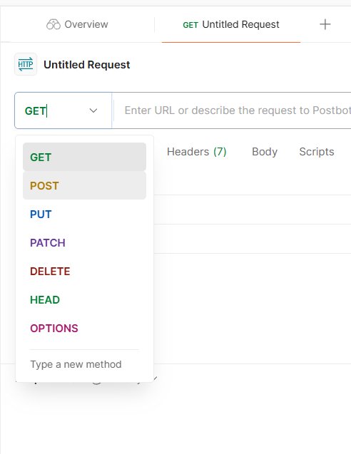
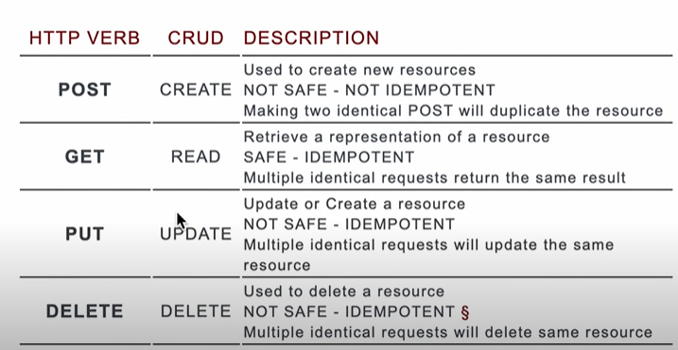
HTTP METHODS

Slide 6
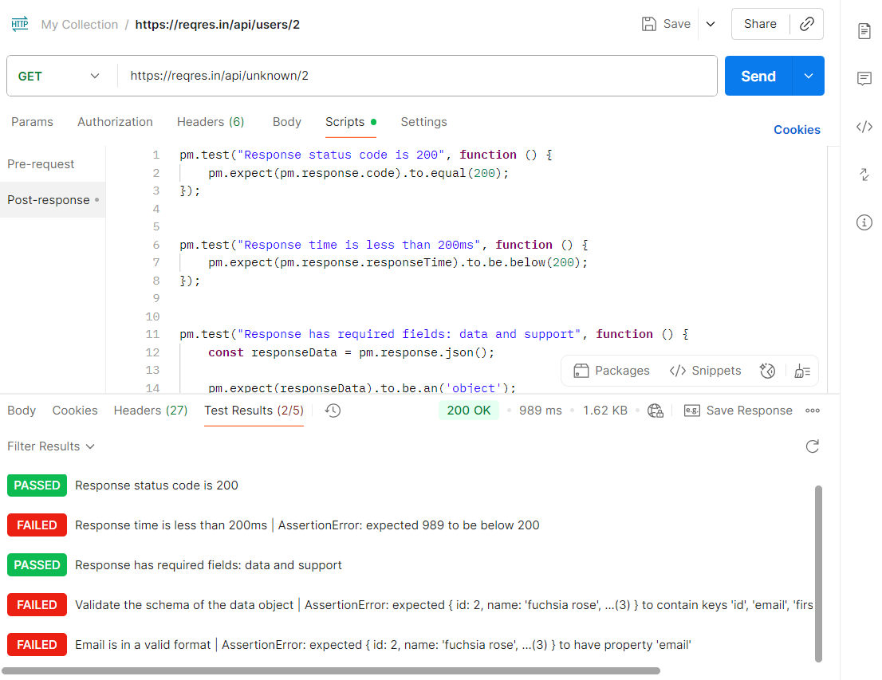
TESTING SOME PUBLICALLY API’S

Slide 7
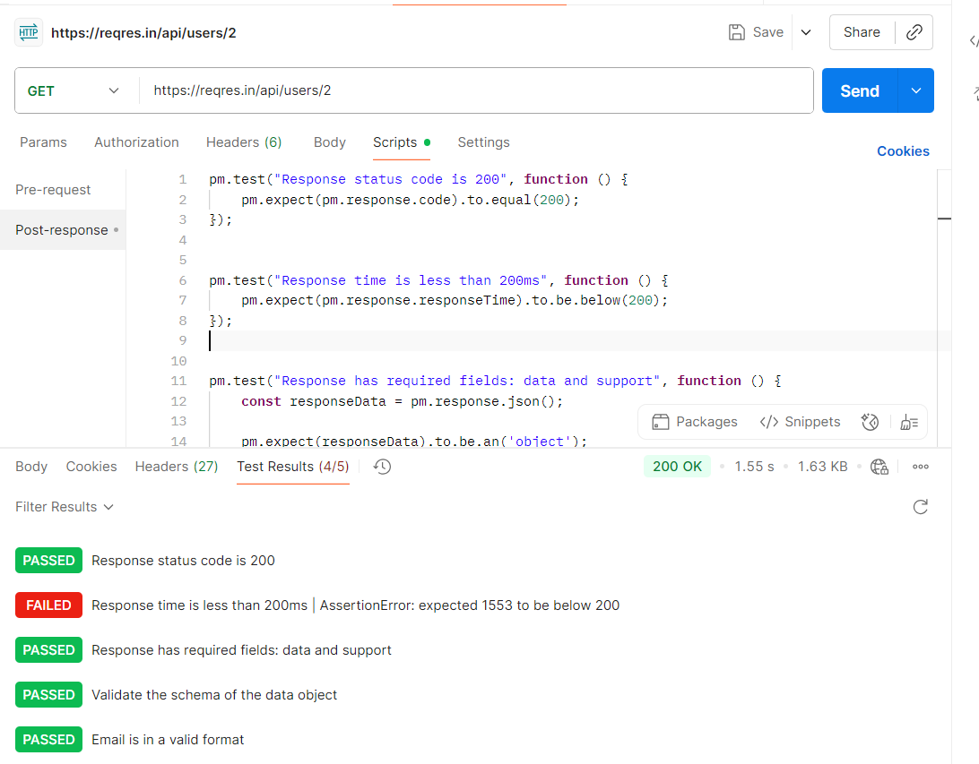
Get single user

Slide 8
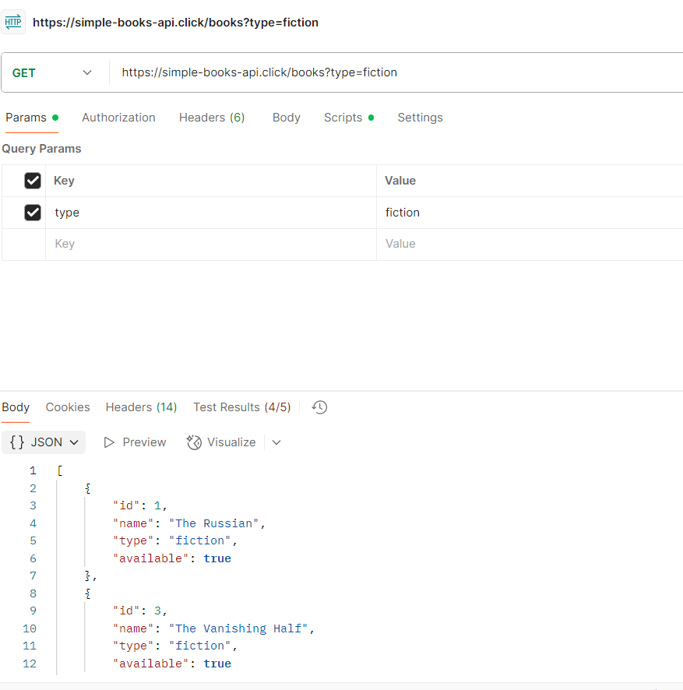
Get List of book with type

Slide 9
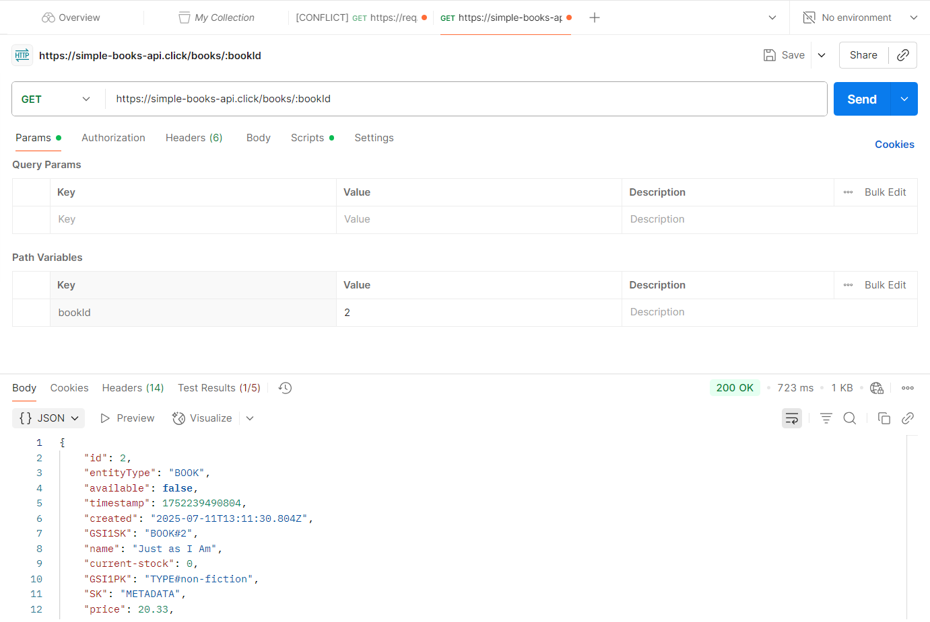
Get a single book with bookid

Slide 10
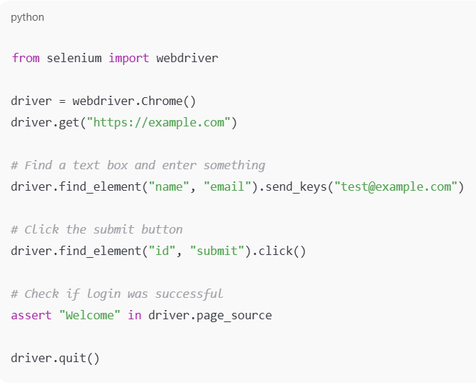
Selenium TOOL USING PYTHON
Selenium is an open-source tool used for automated testing of web applications. It helps testers and developers check whether a web app is working correctly by simulating real user actions like clicking buttons, filling forms, navigating pages, etc. You can write scripts that open a browser, perform actions, and check results automatically!
SELENIUM COMPONENETS:
Selenium WebDriver
Selenium IDE
Selenium Grid
This script opens Chrome, goes to a site, fills out
a form, submits it, and checks the result.

Slide 11
Thank you

